Slide 1
SPARK SQL UNPLUGGED:
A FUN INTRODUCTION
From Raw data to Rich insights

Slide 2
What’s ahead
Why PySpark
Spark SQL
Significance of PySpark SQL
Difference
Hands On example
Real life implementation

Slide 3
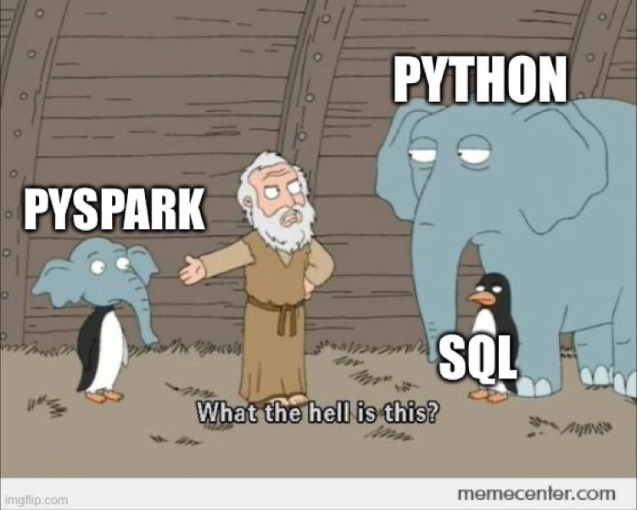
What is PySpark?
PySpark is the Python API for Apache Spark
An open source, distributed computing framework and set of libraries for real-time, large-scale data processing
It enables you to perform real-time, large-scale data processing in a distributed environment using Python.

Slide 4

We all have been there...

Slide 5
Why does it take so long for spark ?
Spark runs on top of a Hadoop cluster
Hadoop keeps data stored on commodity hardware and when a query comes in Spark or MapReduce splits the query into pieces for multiple servers to answer.
It’s the overhead of splitting the query to multiple servers and then reassembling it to makes it slower.
“Every tool has it’s place and Spark is an amazing tool for large workloads,
just not small ones.”

Slide 6

Spark SQL
pyspark
spark submit
spark shell
SQL like queries
Spark SQL
Easy load and
query data
Loading Data
Dataframe
abstraction
Querying data
Dataframe
CSV
JSON
PARQUET
JDBC
TEXT FILE
ELASTIC SEARCH
Input

Slide 7
Significance of Pyspark SQL
PySpark SQL is a Spark library for working with structured and semi-structured data.
SQL queries on massive data sets, playing the role of a distributed SQL query engine.
In conclusion, Spark SQL and DataFrames are two important components of PySpark that provide powerful tools for big data processing

Slide 8
Catalyst Optimizer and tungsten execution engine
It is a rule-based optimizer designed to improve the performance of query execution.
The Tungsten execution engine is a memory-centric execution engine introduced in Spark SQL to achieve better performance and efficiency.

Slide 9
Hands on example

Slide 10
How does it differ from SQL
Execution engine : SQL - RDBMS, PySpark - Spark engine
Performance : SQL - Fast OLTP and small datasets, PySpark - OLAP and big data.
Scalability : SQL - Scales Vertically(RAM) , PySpark - Scales Horzontally(worker nodes)

Slide 11
Usecases
Uber:
Use Case: Uber utilizes Spark SQL for analyzing vast amounts of rider and driver data to optimize ride matching, pricing strategies, and driver incentives.
Airbnb:
Use Case: Airbnb uses Spark SQL for analyzing property listings, booking patterns, and user reviews to optimize pricing strategies, identify market trends, and enhance customer satisfaction.

Slide 12
Thank You!

